Slide 1

APBD – lecture 11
WebAssembly
Blazor – server side

Slide 2
WebAssembly - problems
Earlier in the past, the VM has been ready to load only JavaScript. This has worked well for us as JavaScript is powerful enough to resolve most problems people face on the internet today.
We have got run into performance problems, however, when trying to use JavaScript for more compelling use cases like Virtual and Augmented Reality( VR and AR), 3D games, computer vision, image/video editing, and different other domains that demand native performance.

Slide 3
WebAssembly - problems
Additionally, the value of downloading, compiling and parsing huge JavaScript apps are prohibitive. Smart Phones and other resource-constrained platforms can further amplify these performance bottlenecks.
With the arrival of WebAssembly appearing in browsers, the virtual machine that we talked about earlier will now load and run two forms of code — JavaScript and WebAssembly.

Slide 4
What is WebAssembly?
WebAssembly is a new type of code that can be run in modern web browsers and provides new features and major gains in performance. It is not primarily intended to be written by hand, rather it is designed to be an effective compilation target for source languages like C, C++, Rust, etc.
This has huge implications for the web platform — it provides a way to run code written in multiple languages on the web at near-native speed, with client apps running on the web that previously couldn’t have done so.

Slide 5
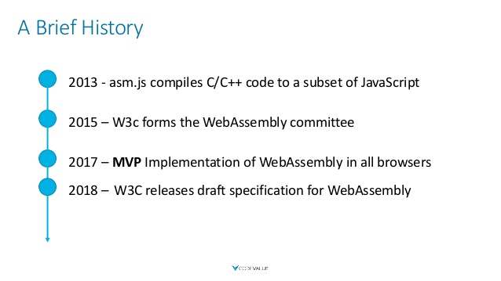
WebAssembly

Slide 6
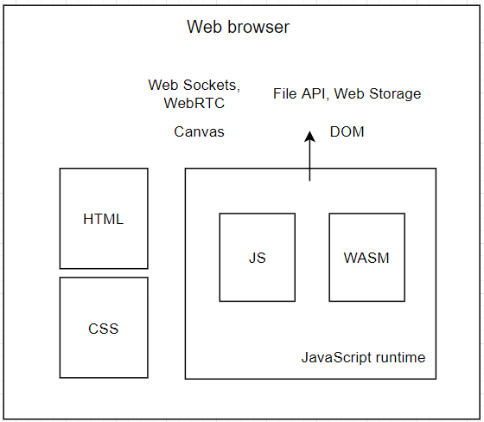
WebAssembly

Slide 7


JavaScript vs WASM

Slide 8
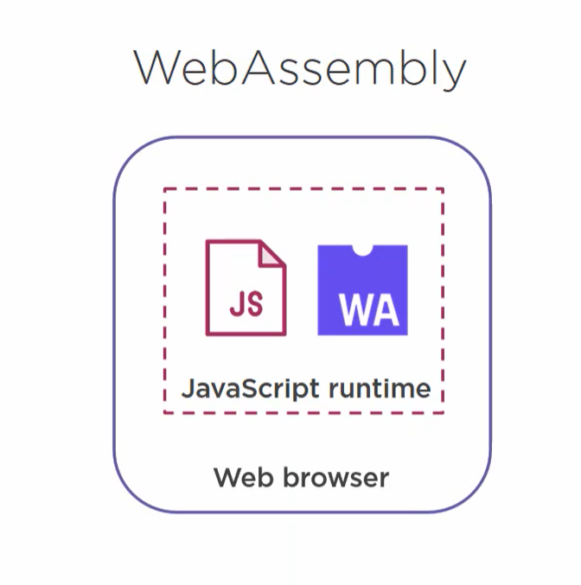
JavaScript vs WASM

Slide 9
WASM
WebAssembly is a binary instruction format for a stack-based virtual machine
WASM is designed as a portable target for compilation of high-level languages like C/C++/Rust enabling deployment on the web for client/server applications

Slide 10
What is WebAssembly?
WebAssembly is a new type of code that can be run in modern web browsers and provides new featurWhat’s more, you don’t even have to know how to create WebAssembly code to take advantage of it.
WebAssembly modules can be imported into a web (or Node.js) app, exposing WebAssembly functions for use via JavaScript.
JavaScript frameworks could make use of WebAssembly to confer massive performance advantages and new features while still making functionality easily available to web developers.s and major gains in performance. It is not primarily intended to be written by hand, rather it is designed to be an effective compilation target for source languages like C, C++, Rust, etc.

Slide 11
WebAssembly goals
WebAssembly is being created as an open standard inside the W3C WebAssembly Community Group with the following goals:
Be fast, efficient, and portable — WebAssembly code can be executed at near-native speed across different platforms by taking advantage of common hardware capabilities.
Be readable and debuggable — WebAssembly is a low-level assembly language, but it does have a human-readable text format (the specification for which is still being finalized) that allows code to be written, viewed, and debugged by hand.

Slide 12
WebAssembly goals
Keep secure — WebAssembly is specified to be run in a safe, sandboxed execution environment. Like other web code, it will enforce the browser's same-origin and permissions policies.
Don't break the web — WebAssembly is designed so that it plays nicely with other web technologies and maintains backwards compatibility.

Slide 13
WebAssembly
WebAssembly Compatability with Web Platform. The web platform is thought of as having two parts:
A virtual machine (VM) that runs the web applications code, e.g. the JS code that powers your apps.
A set of Web APIs that a web application can call to regulate web browser/device functionality and make things happen (CSSOM, DOM, IndexedDB, WebGL, Web Audio API, etc.).

Slide 14
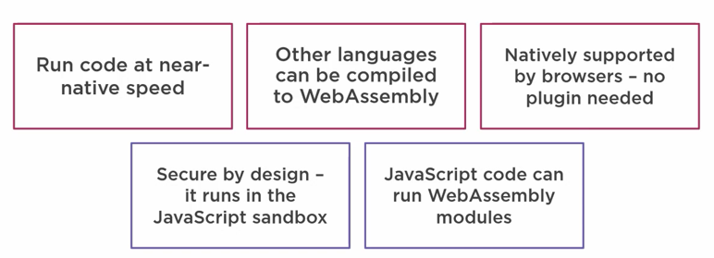
WebAssembly - benefits

Slide 15
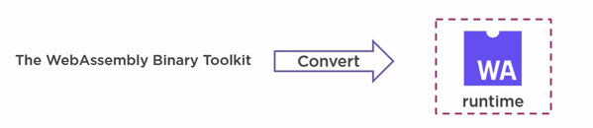
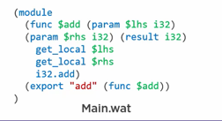
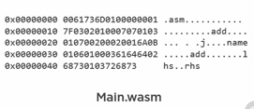
Write WebAssembly Yourself
https://webassembly.studio/

Slide 16
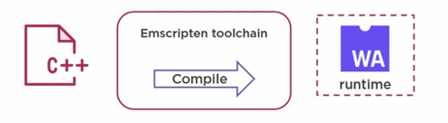
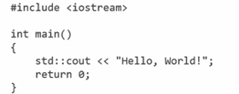
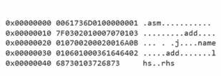
WebAssembly – C++

Slide 17
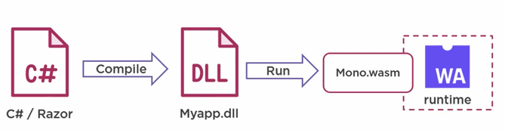
WebAssembly – C#

Slide 18
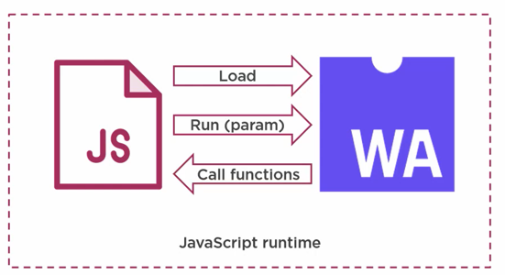
WebAssembly and JS

Slide 19
Blazor
Blazor is a framework for building interactive client-side web UI with .NET:
Create rich interactive UIs using C# instead of JavaScript.
Share server-side and client-side app logic written in .NET.
Render the UI as HTML and CSS for wide browser support, including mobile browsers.
Integrate with modern hosting platforms, such as Docker.

Slide 20
Blazor - components
Blazor apps are based on components. A component in Blazor is an element of UI, such as a page, dialog, or data entry form.
Components are .NET C# classes built into .NET assemblies that:
Define flexible UI rendering logic. \
Handle user events.
Can be nested and reused.
Can be shared and distributed as Razor class libraries or NuGet packages.

Slide 21
Blazor WebAssembly
Blazor WebAssembly is a single-page app (SPA) framework for building interactive client-side web apps with .NET.
Blazor WebAssembly uses open web standards without plugins or recompiling code into other languages.
Blazor WebAssembly works in all modern web browsers, including mobile browsers.
Running .NET code inside web browsers is made possible by WebAssembly (abbreviated wasm).

Slide 22
Blazor WebAssembly
When a Blazor WebAssembly app is built and run in a browser:
C# code files and Razor files are compiled into .NET assemblies.
The assemblies and the .NET runtime are downloaded to the browser.
Blazor WebAssembly bootstraps the .NET runtime and configures the runtime to load the assemblies for the app. The Blazor WebAssembly runtime uses JavaScript interop to handle DOM manipulation and browser API calls.

Slide 23
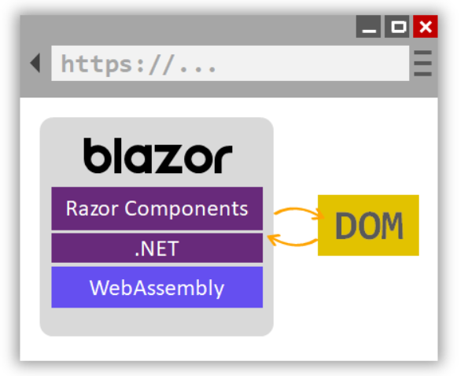
Blazor WebAssembly

Slide 24
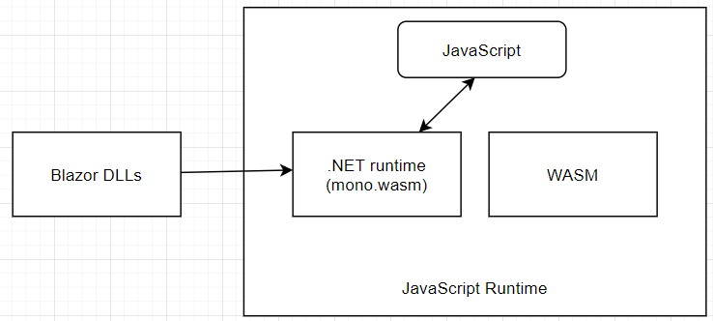
Blazor – Client side

Slide 25
Blazor Server
Blazor decouples component rendering logic from how UI updates are applied.
Blazor Server provides support for hosting Razor components on the server in an ASP.NET Core app. UI updates are handled over a SignalR connection.

Slide 26
Blazor Server
The runtime stays on the server and handles:
Executing the app's C# code.
Sending UI events from the browser to the server.
Applying UI updates to the rendered component that are sent back by the server.
The connection used by Blazor Server to communicate with the browser is also used to handle JavaScript interop calls.

Slide 27
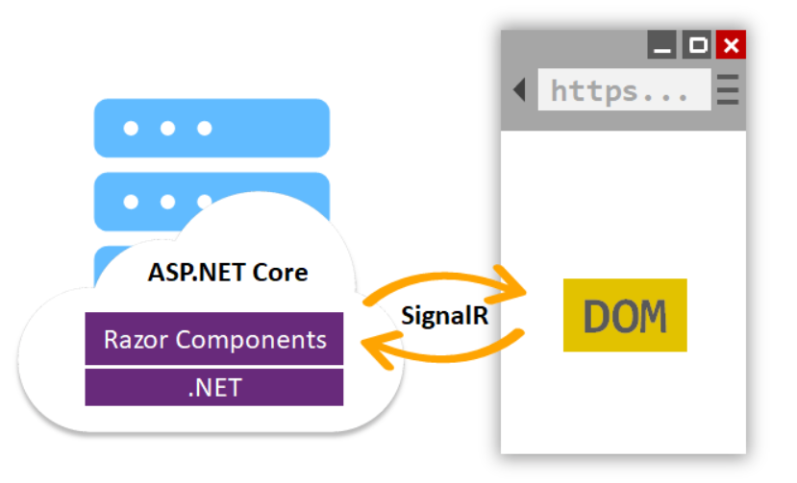
Blazor Server

Slide 28
@page directive
Routing tules helps us define which component will appear on the screen according to the URL in which the user is located
There routing rules are configured using the @page directive

Slide 29
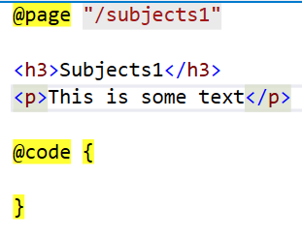
@page directive

Slide 30
App.razor
App.razor defines our routing template
By default defines the view that will be displayed in case of a missing element
Otherwise displays the component based by the route

Slide 31
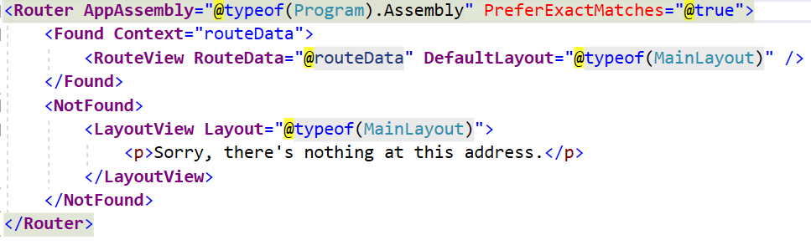
App.razor

Slide 32
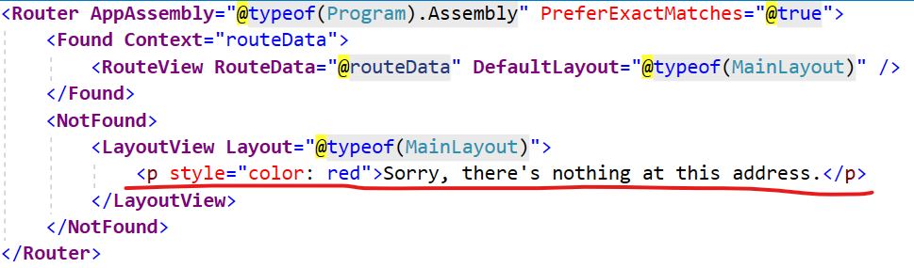
App.razor- changing the 404 page

Slide 33
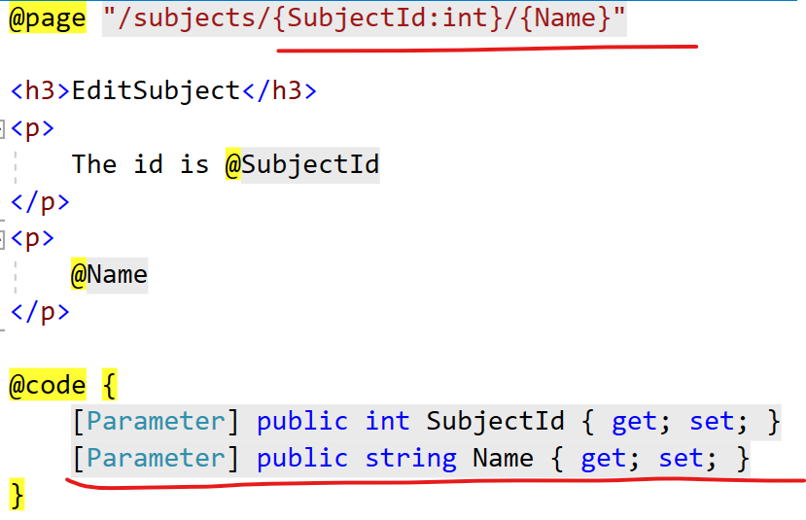
Route params

Slide 34
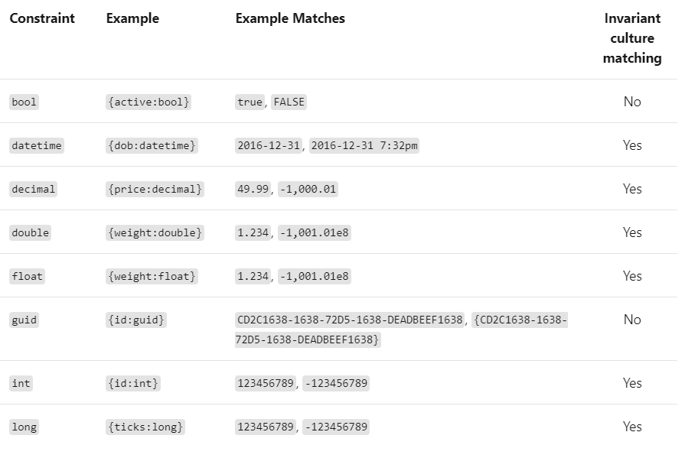
Route constraints

Slide 35
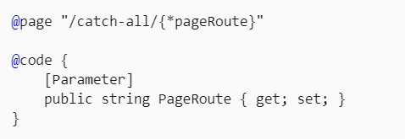
Catch-all route

Slide 36
NavigationManager
Use NavigationManager to manage URIs and navigation in C# code. NavigationManager provides the event and methods shown in the following table.

Slide 37
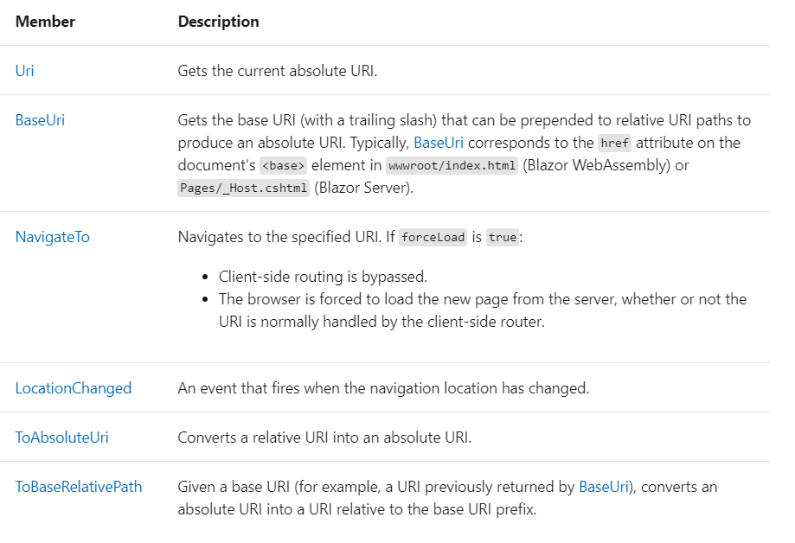
NavigationManager

Slide 38
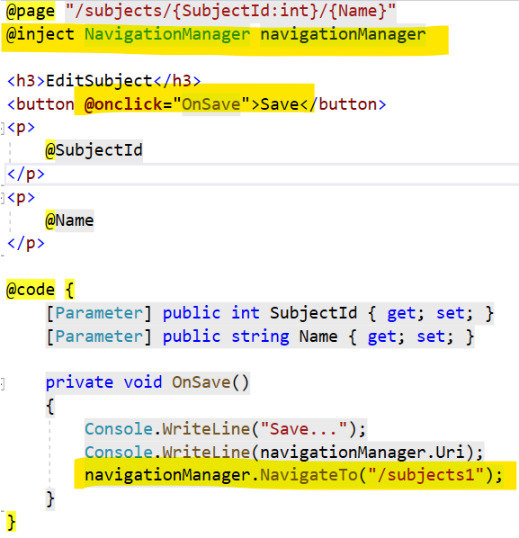
NavigationManager

Slide 39
Working with Razor
Razor is a markup syntax for embedding server-based code into webpages. The Razor syntax consists of Razor markup, C#, and HTML. Files containing Razor generally have a .cshtml file extension. Razor is also found in Razor components files (.razor).
https://docs.microsoft.com/en-us/aspnet/core/mvc/views/razor?view=aspnetcore-5.0

Slide 40
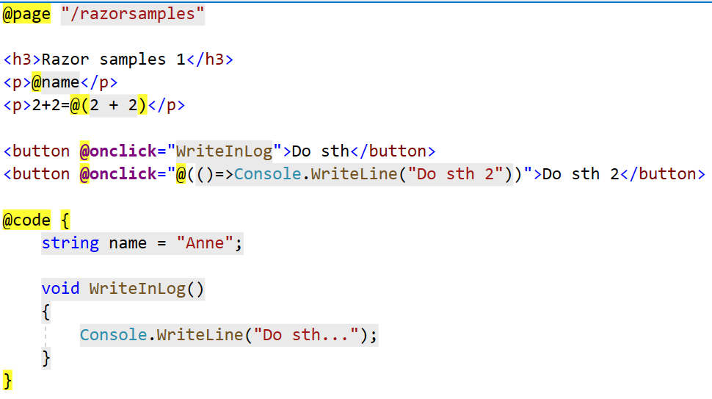
Working with Razor

Slide 41
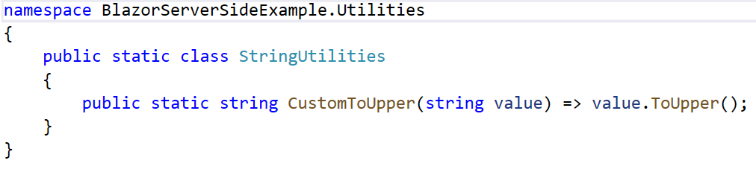
Working with Razor - classes
Let’s define a separate class

Slide 42
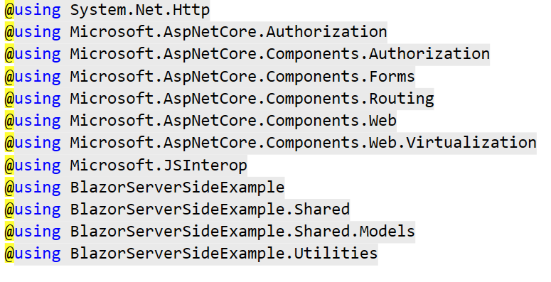
Working with Razor - classes
We can use _Imports.razor file to define the common imports available in all the components

Slide 43
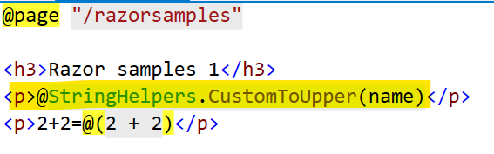
Working with Razor - classes

Slide 44
Working with Razor – loops/conditionals
Lets create a Models folder with a student class

Slide 45
Working with Razor
Using MarkupString allows us to interpret corretly the HTML (carefull with injections)

Slide 46
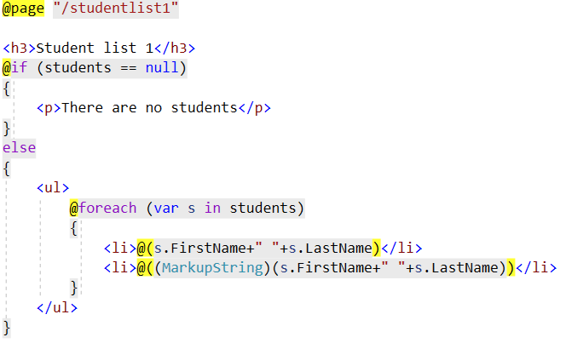
Working with Razor

Slide 47
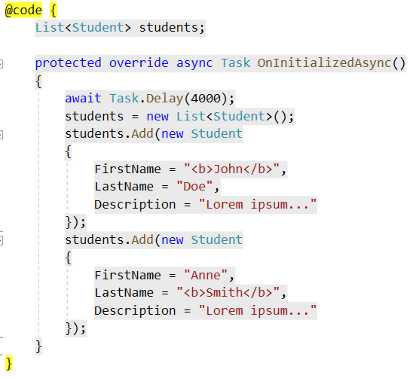
Working with Razor

Slide 48
Components
A component is a resuable piece of user interface, which may contain logic
A component is a class
We can nest component to create complex interfaces
Similar idea to other frontend technologies like React/Angular/Vue

Slide 49
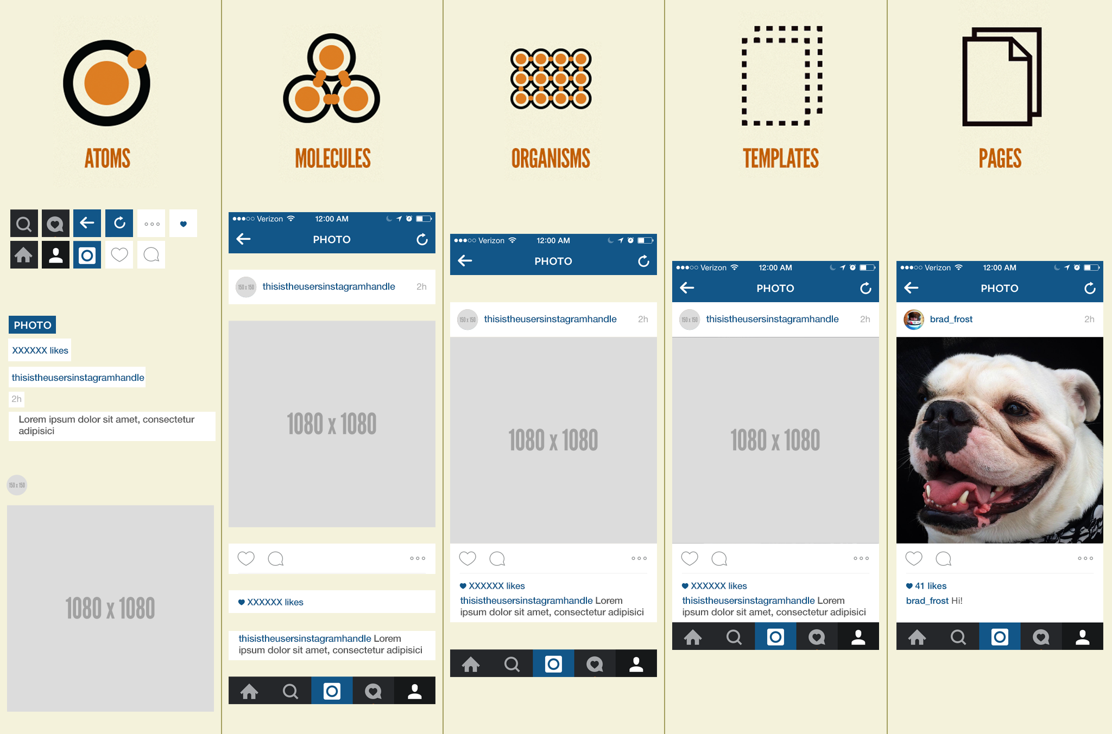
Atomic design

Slide 50
First component - StudentsList
Let’s extract the Students list to a separate razor component – Shared/StudentsList.razor

Slide 51
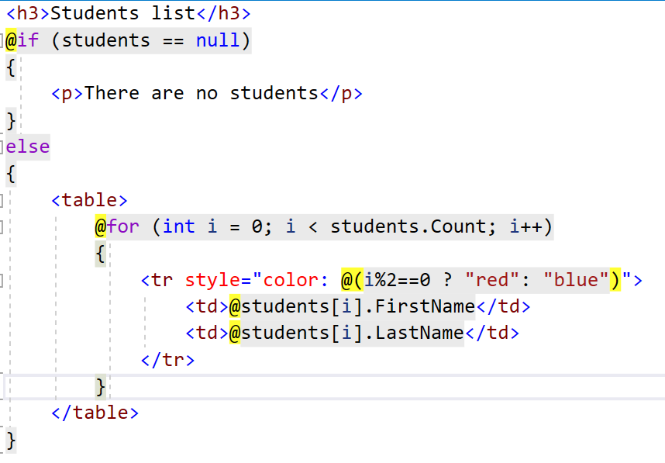
StudentsList.razor

Slide 52
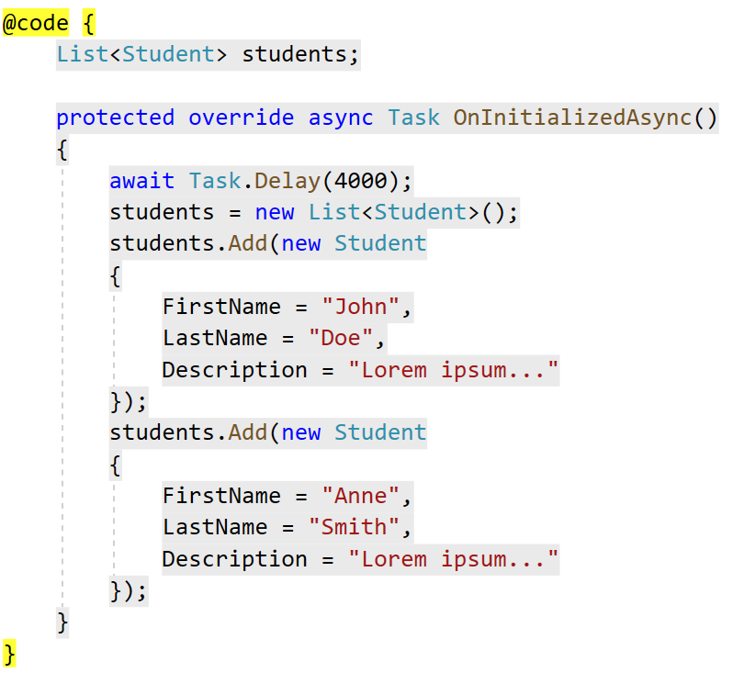
StudentsList.razor

Slide 53
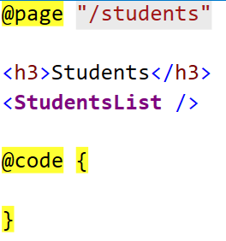
Using component
Then we can create a new page Students in which we can use our previously created StudentsList.razor component

Slide 54
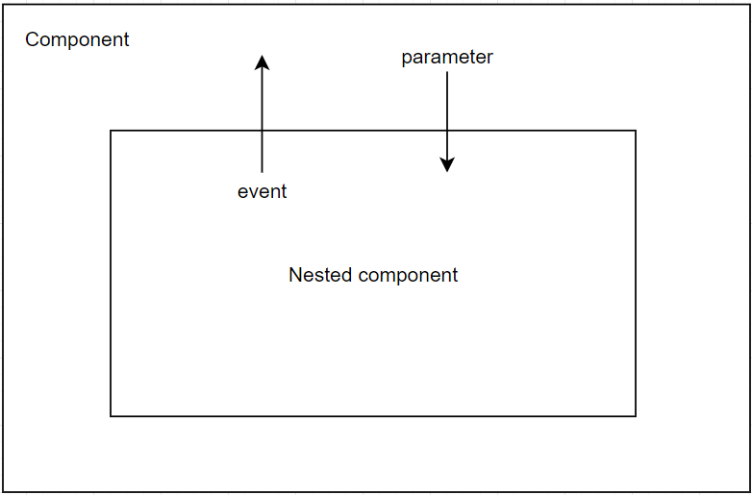
Parameters
A component can receive parameters through its parameters
Parameters can be data, events, content

Slide 55
Parameter - StudentList
Let’s assume we can pass a list of students from parent component to child component.
To do that we have to add the [Parameter] property to the StudentList component.

Slide 56
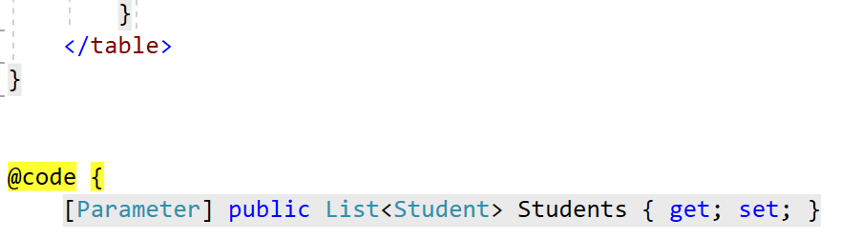
Parameter - StudentList

Slide 57
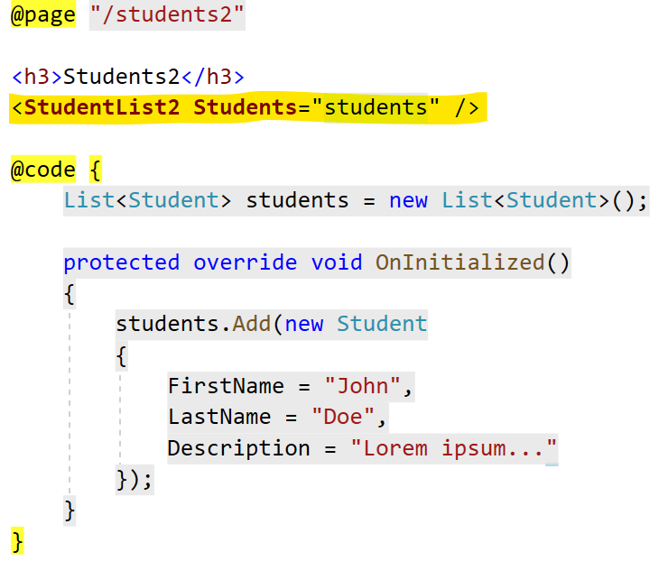
Parameter - StudentList
Now we can pass a list of students from parent component

Slide 58
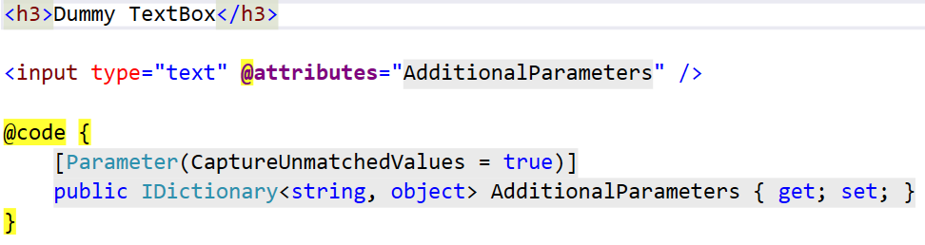
Arbitrary parameters
Allows us to easily pass multiple parameters at once

Slide 59
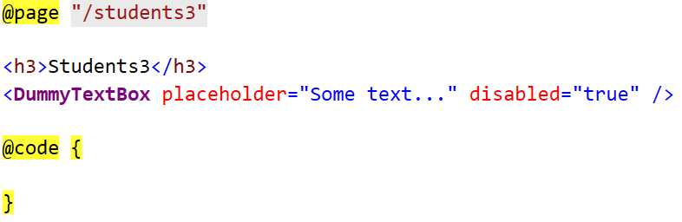
Arbitrary parameters

Slide 60
Data binding
Allows us to synchronize the control with the data
Razor components provide data binding features with the @bind Razor directive attribute with a field, property, or Razor expression value.

Slide 61
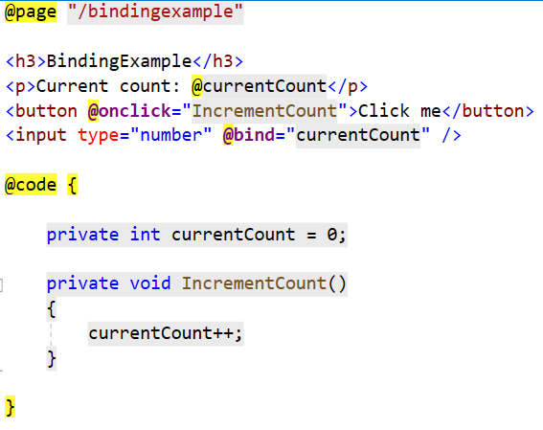
Data binding

Slide 62
Event callback
Events allows us to pass data from child component to the parent component.
Parent passed even handler to the child component. Then the child component calls the event handler and passes the data to the parent controller

Slide 63
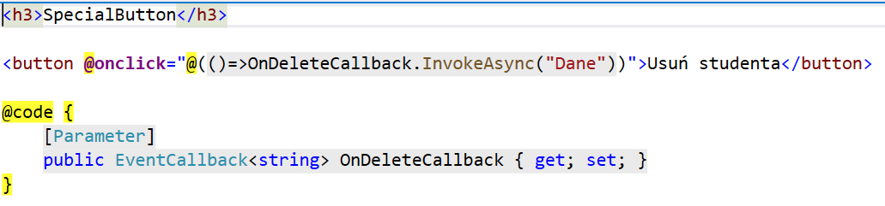
Event callback - child

Slide 64
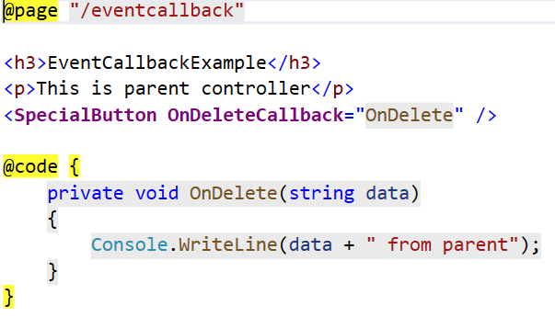
Event callback - parent

Slide 65
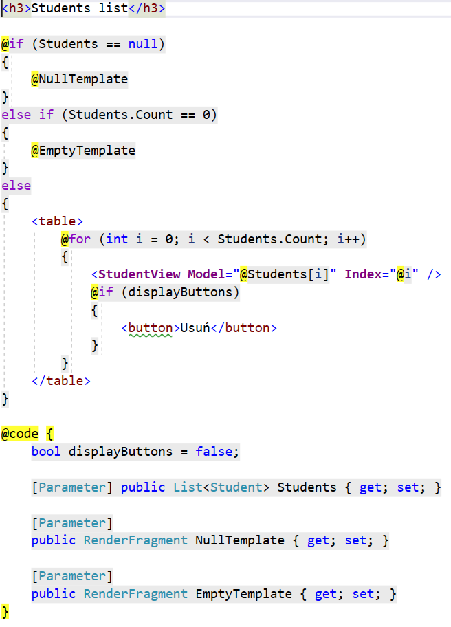
Render fragment
RenderFragment is used to render components or content at run time in Blazor.
The RenderFragment class allows you to create the required content or component in a dynamic manner at runtime. In the following code example, the content is created at runtime on OnInitialized.

Slide 66
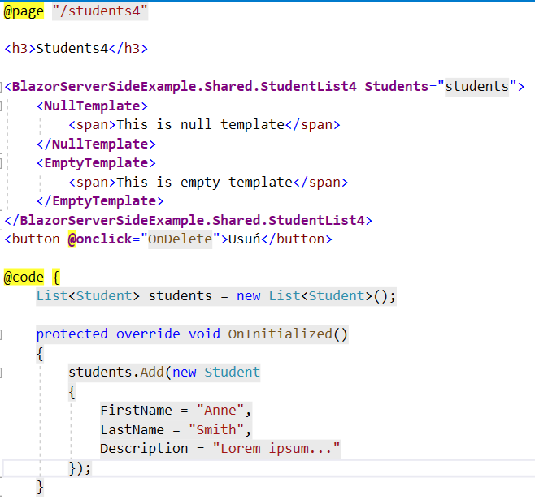
Render fragment

Slide 67
Lifecycle of a Component
OnInitialized and OnInitializedAsync
OnParameterSet and OnParameterSetAsync
OnAfterRender and OnAfterRenderAsync
ShouldRender

Slide 68
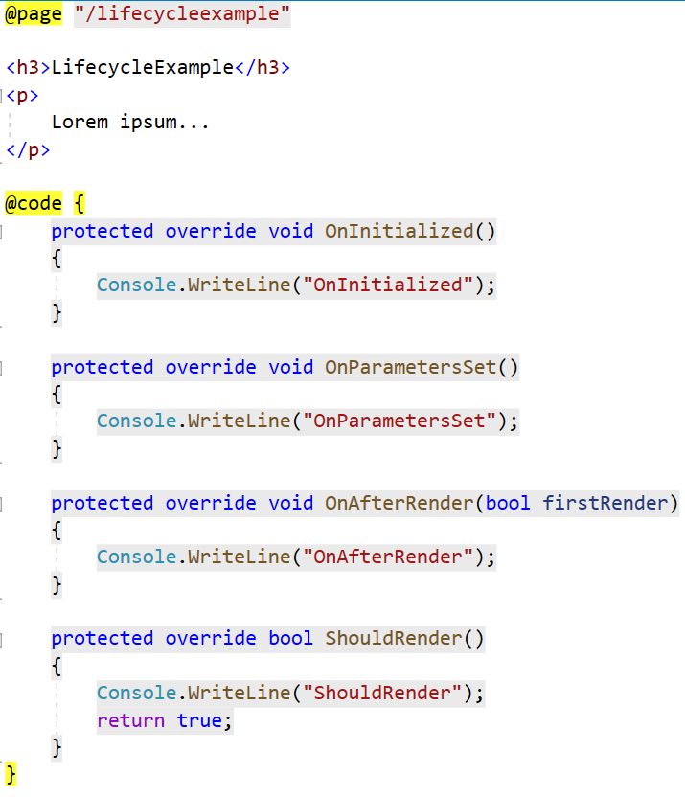
Lifecycle of a Component

Slide 69
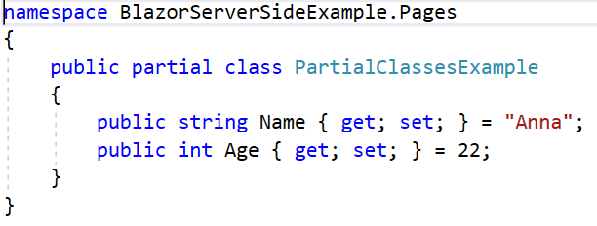
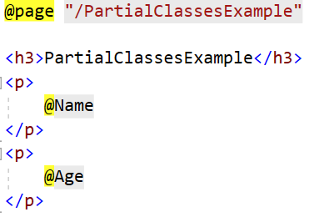
Partial classes

Slide 70
Bibliography
https://developer.mozilla.org/en-US/docs/WebAssembly/Concepts
https://gavilan.blog/blog/
https://docs.microsoft.com/en-us/aspnet/core/blazor/fundamentals/routing?view=aspnetcore-5.0
https://atomicdesign.bradfrost.com/chapter-2/

